Slide 1

CAP615 PROGRAMMING IN JAVA

Slide 2
Array
Array is a collection of similar type of elements that have contiguous memory location.
In java, array is an object the contains elements of similar data type.
It is a data structure where we store similar elements. We can store only fixed elements in an array.
Array is index based, first element of the array is stored at 0 index.

Slide 3
Advantage of Array
Code Optimization: It makes the code optimized, we can retrieve or sort the data easily.
Random access: We can get any data located at any index position.
Disadvantage of Array
Size Limit: We can store only fixed size of elements in the array. It doesn't grow its size at runtime. To solve this problem, collection framework is used in java.

Slide 4
Types of Array: There are two types of array.
Single Dimensional Array
Multidimensional Array-
2D array
3D array
Jagged array

Slide 5
Single Dimensional Array
The syntax for declaring and instantiating an array:
There are two ways to declare an array,
type[] arrayName;
type arrayName[];

Slide 6
How to instantiate an array
arrayName = new type[length];
How to declare and instantiate an array in one statement
type[] arrayName = new type[length];

Slide 7
Examples
Array of integers
int[] num = new int[5];
Array of Strings
String[] nameList = new String[5];
nameList[0] = "Amanda Green";
nameList[1] = "Vijay Arora";
nameList[2] = "Sheila Mann";
nameList[3] = "Rohit Sharma";
nameList[4] = "Mandy Johnson";

Slide 8
Enhanced For loop
for(data_type variable : array | collection)
{
//body of for-each loop
}

Slide 9
Example:
int []myArray=new int[]{11,12,13,14,15};
for(int num : myArray)
{
System.out.println(num);
}

Slide 10
Array length
The syntax for getting the length of an array
arrayName.length
e.g-
int[] values = new int[10];
for (int i = 0; i < values.length; i++)
{
values[i] = i;
}

Slide 11
What will be output?
public class Main
{
public static void main(String[] args)
{
int arr[]={010,102,17};
for(int i=0;i<arr.length;i++)
{
System.out.print(arr[i]+” “);
}
}
}
10 102 17
010 102 17
8 102 17
Error

Slide 12
Two-dimensional arrays
The syntax for creating a rectangular array-
type[][] arrayName = new type[rowCount][columnCount];
A statement that creates a 3x2 array
int[][] numbers = new int[3][2];
3x2 array and initializes it in one statement
int[][] numbers =new int[][] { { 1, 2 }, { 3, 4 }, { 5, 6 } };

Slide 13
public class Main
{
public static void main(String[] args)
{
int array_variable [] = new int[10];
for (int i = 0; i < 10; i++)
{
array_variable[i] = i;
System.out.print(array_variable[i] + " ");
i++;
}
}
}
a) 0 2 4 6 8 b) 1 3 5 7 9 c) 0 1 2 3 4 5 6 7 8 9 d) 1 2 3 4 5 6 7 8 9 10

Slide 14
Jagged array
type[][] arrayName = new type[rowCount][];
e.g:-int num[][]=new int[4][];
num[0]=new int[1];
num[1]=new int[2];
num[2]=new int[3];
num[3]=new int[4];

Slide 15
Enhanced for loop for 2D array
for (int[] num: arr)
{
for(int data: num)
{
System.out.println(data);
}
}

Slide 16
Arrays class in Java
The Arrays class in java.util package is a part of the Java Collection Framework.
Arrays.sort()
e.g-
int[] numbers = {2,6,4,1,8,5,9,3,7,0}; Arrays.sort(numbers);
for (int num : numbers)
{
System.out.print(num + " ");
}

Slide 17
Some other methods:
equals( arrayName1, arrayName2 )
copyOf( arrayName, length )
binarySearch( arrayName, search_key )

Slide 18
import java.util.*;
public class Main
{
public static void main(String[] args)
{
int[] intArr =new int[] {2,6,4,10,8,5,9,3,7,1};
Arrays.sort(intArr);
// entering the value to be searched
int searchVal = 10;
int retVal = Arrays.binarySearch(intArr,searchVal);
System.out.println("The index of element 1 is : " + retVal);
}
}

Slide 20
3 d array:
Syntax:
array_type[][][] array_name = new array_type[x][y][z];
Ex:
int[][][] num=new int[2][3][4];
Here, num[i][j][k] where ‘i’ is the array number, ‘j’ is the row number and ‘k’ is the column number.

Slide 21
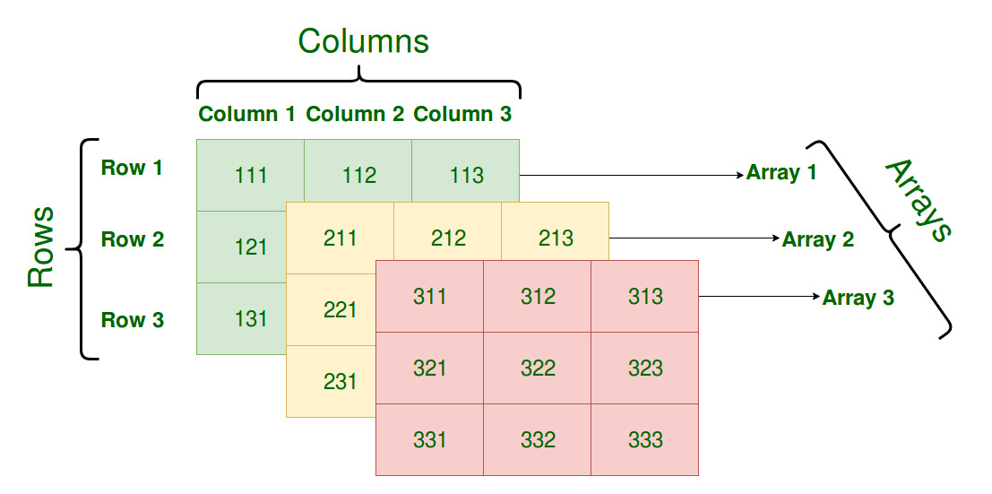

Slide 22
4 D Array
Array of 3 D Array
int [][][][] num=new int[2][2][2][2];
Multi dimensional array means array of arrays.

